Slide 1
Trees

Slide 2
Content
Introduction to Trees.
Introduction to Binary Trees.
Traversing Binary Trees.
Introduction to Binary Search Trees.
Insertion into Binary Search Trees.
Huffman Algorithm for Data Encoding.

Slide 3
Tree
A tree is a graph with the following properties:
The graph is connected (can go from anywhere to anywhere)
There are no cycles(acyclic)
Graphs that are not trees
Tree

Slide 4
Definition
A tree consists of finite set of elements, called nodes, and a finite set of directed lines called branches, that connect the nodes.
A tree is a connected graph without any circuits

Slide 5
Introduction to Trees
A Tree is a finite set of elements called nodes such that:
There is specially designated node called the root.
The remaining nodes are partitioned into disjoint sets T₁,….T_{n} where each of these sets is also tree called sub trees of the root.
Each node can have 0 or more children.
A node can have at most one parent.
A
B
C
D
E
F
G

Slide 6
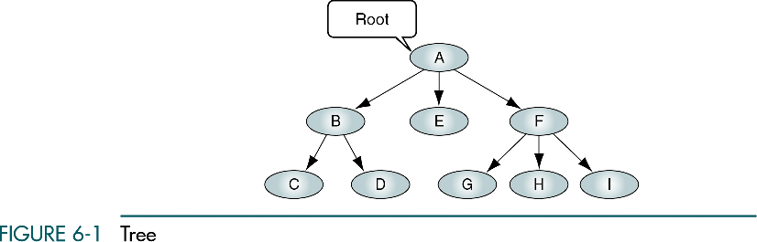

Slide 7
Basic Tree Concepts
When the branch is directed toward the node, it is indegree branch.
When the branch is directed away from the node, it is an outdegree branch.
The sum of the indegree and outdegree branches is the degree of the node.
If the tree is not empty, the first node is called the root.

Slide 8
Basic Tree Concepts
The indegree of the root is, by definition, zero.
With the exception of the root, all of the nodes in a tree must have an indegree of exactly one; that is, they may have only one predecessor.
All nodes in the tree can have zero, one, or more branches leaving them; that is, they may have outdegree of zero, one, or more.

Slide 9
Basic Tree Concepts
A leaf is any node with an outdegree of zero, that is, a node with no successors.
A node that is not a root or a leaf is known as an internal node.
A node is a parent if it has successor nodes; that is, if it has outdegree greater than zero.
A node with a predecessor is called a child.

Slide 10
Basic Tree Concepts
Two or more nodes with the same parents are called siblings.
A path is a sequence of nodes in which each node is adjacent to the next node.
The level of a node is its distance from the root. The root is at level 0, its children are at level 1, etc. …

Slide 11
Basic Tree Concepts
The height of the tree is the level of the leaf in the longest path from the root plus 1. By definition the height of any empty tree is 1.
A subtree is any connected structure below the root. The first node in the subtree is known is the root of the subtree.

Slide 12
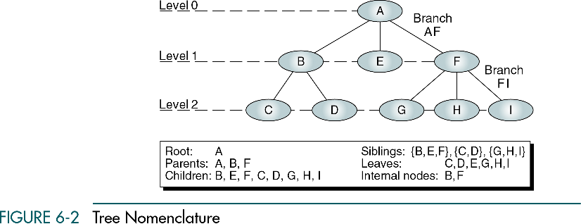

Slide 13
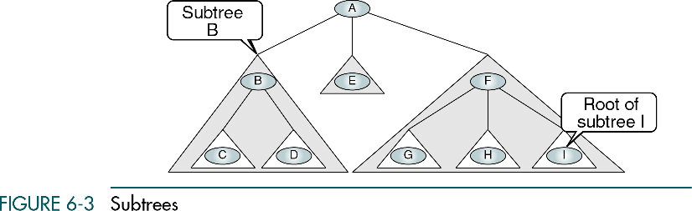

Slide 14
Binary Trees
A binary tree is a tree in which no node can have more than two subtrees; the maximum outdegree for a node is two.
In other words, a node can have zero, one, or two subtrees.
These subtrees are designated as the left subtree and the right subtree.

Slide 15
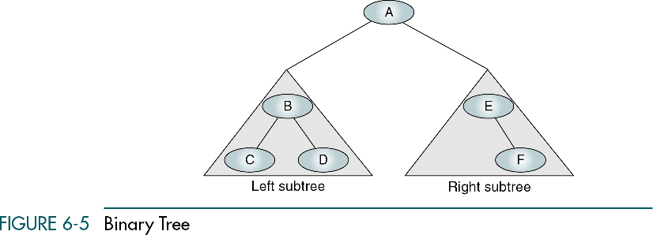

Slide 16
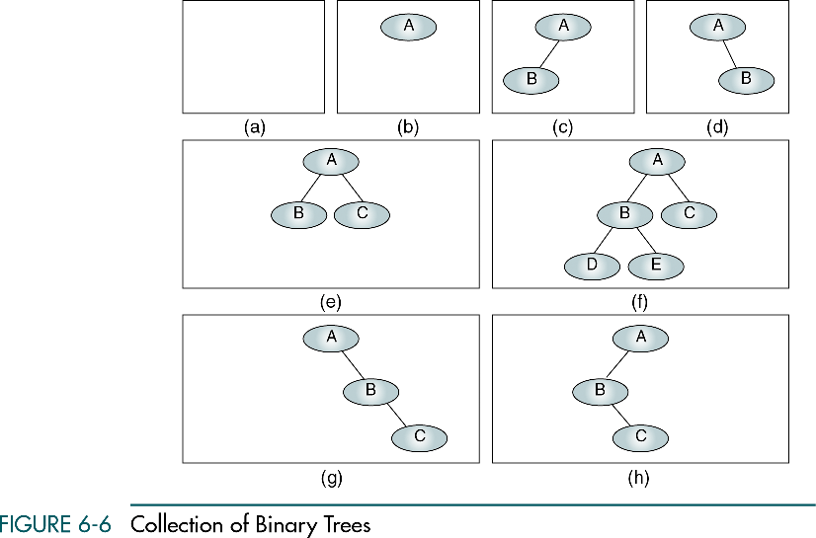
A null tree is a tree with no nodes

Slide 17
Binary Tree Traversal
A binary tree traversal requires that each node of the tree be processed once and only once in a predetermined sequence.
Preorder Traversal (PLR)
Inorder Traversal (LPR)
Postorder Traversal (LRP)

Slide 18
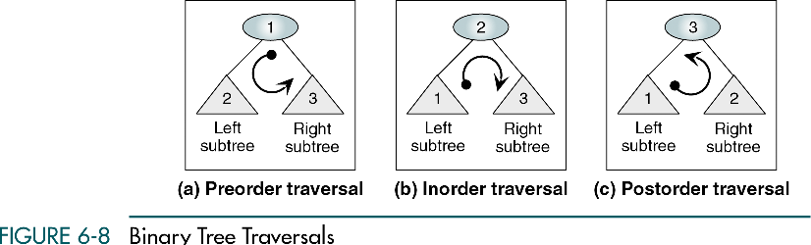

Slide 19
Traversing Binary Trees
There are three standard ways of traversing a binary tree T with root R are,
Preorder
Process the root R.
Traverse the left subtree of R in preorder.
Traverse the right subtree of R in preorder.
A
A
A
B
C
B
C
B
C
D
E
F
G
D
E
F
G
D
E
F
G

Slide 20
Traversing Binary Trees
Preorder: A B D E C F G
A
A
A
B
C
B
C
B
C
D
E
F
G
D
E
F
G
D
E
F
G
A
B
C
D
E
F
G

Slide 21
Traversing Binary Trees
Inorder
Traverse the left subtree of R in inorder.
Process the root R.
Traverse the right subtree of R in inorder.
A
A
A
B
C
B
C
B
C
D
E
F
G
D
E
F
G
D
E
F
G

Slide 22
Traversing Binary Trees
Inorder: D B E A F C G
A
A
A
B
C
B
C
B
C
D
E
F
G
D
E
F
G
D
E
F
G
A
B
C
D
E
F
G

Slide 23
Traversing Binary Trees
Postorder
Traverse the left subtree of R in inorder.
Traverse the right subtree of R in inorder.
Process the root R.
A
A
A
B
C
B
C
B
C
D
E
F
G
D
E
F
G
D
E
F
G

Slide 24
Traversing Binary Trees
Postorder: D E B F G C A
A
A
A
B
C
B
C
B
C
D
E
F
G
D
E
F
G
D
E
F
G
A
B
C
D
E
F
G

Slide 25
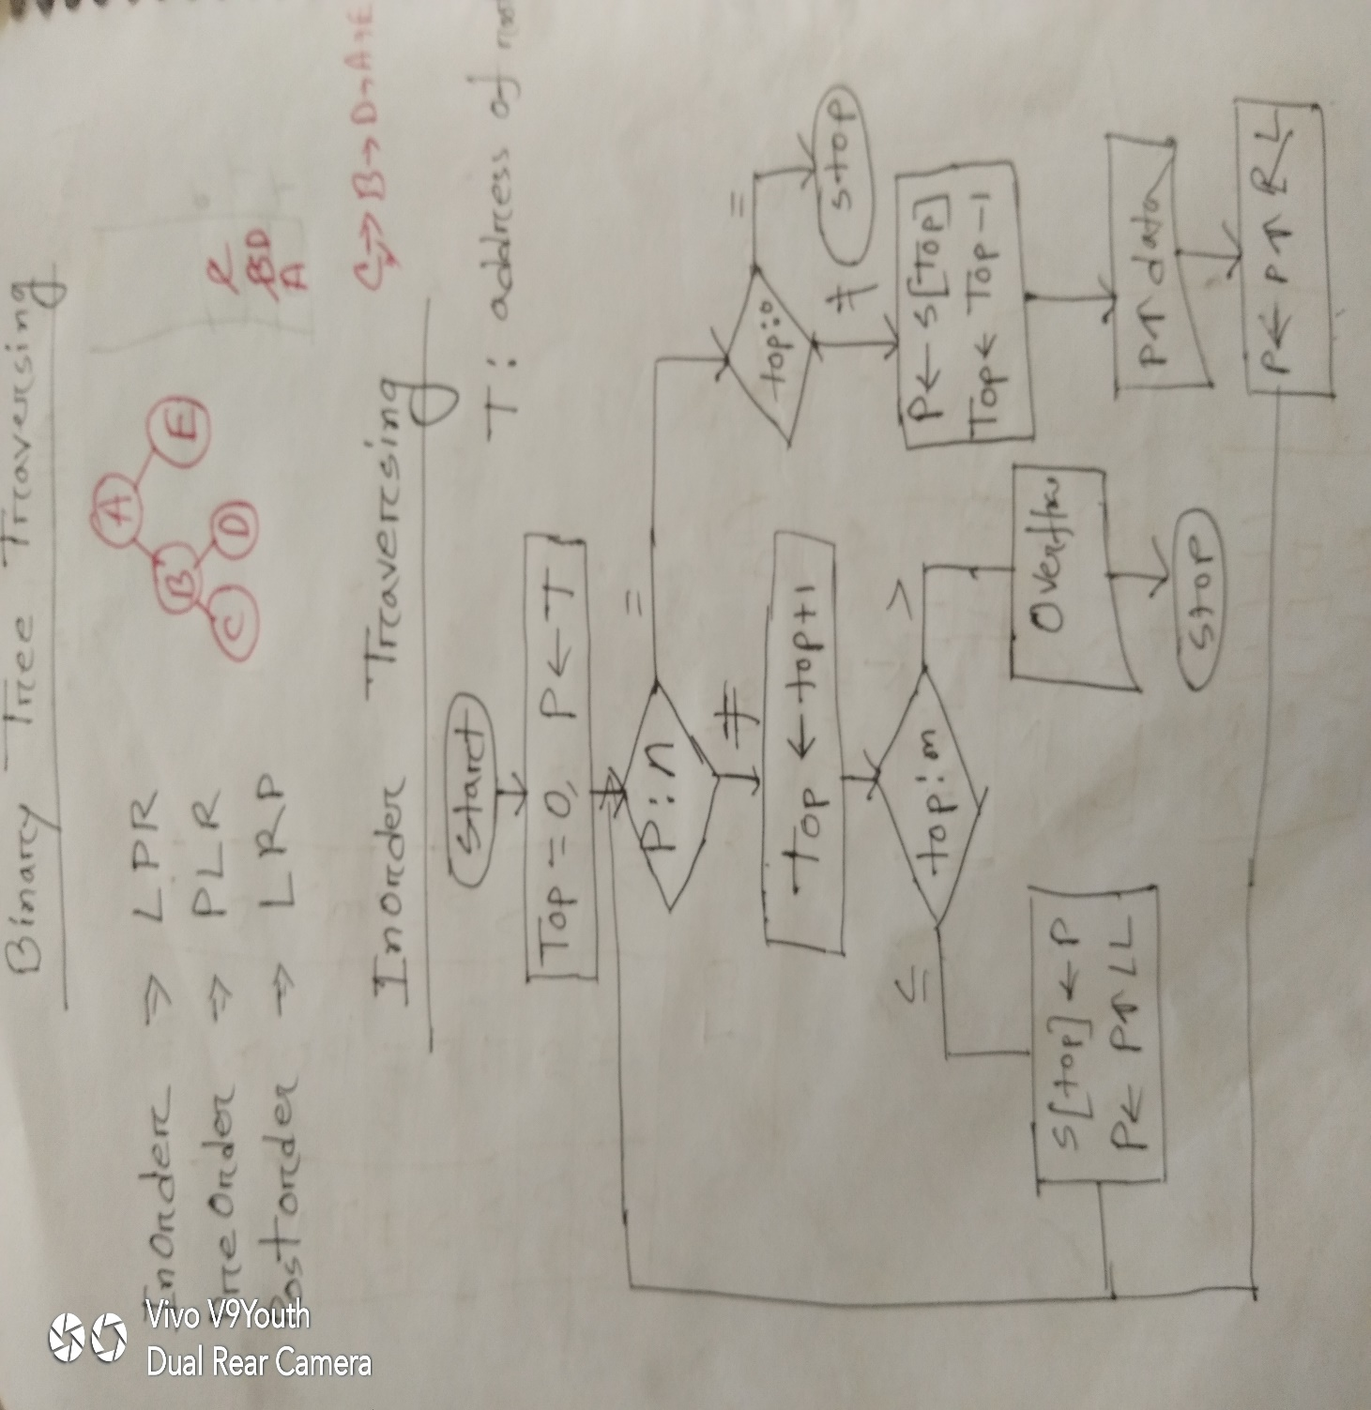
Inorder Traversing

Slide 26
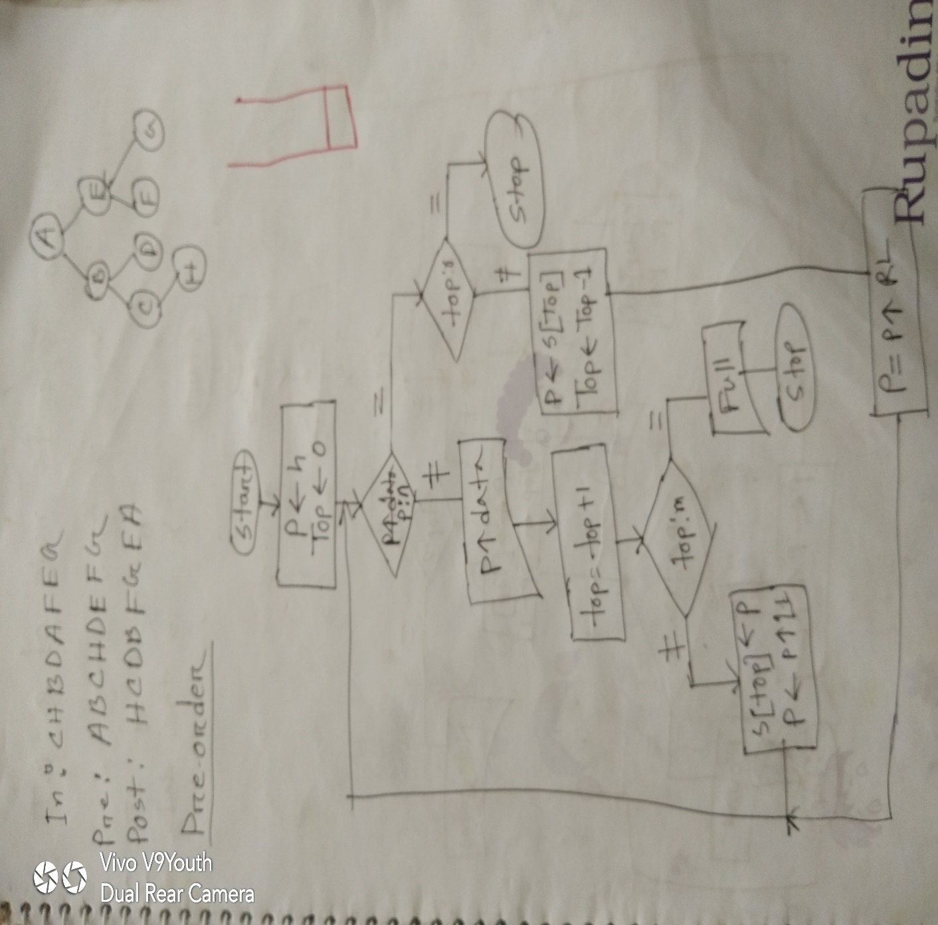
Preorder Traversing

Slide 27
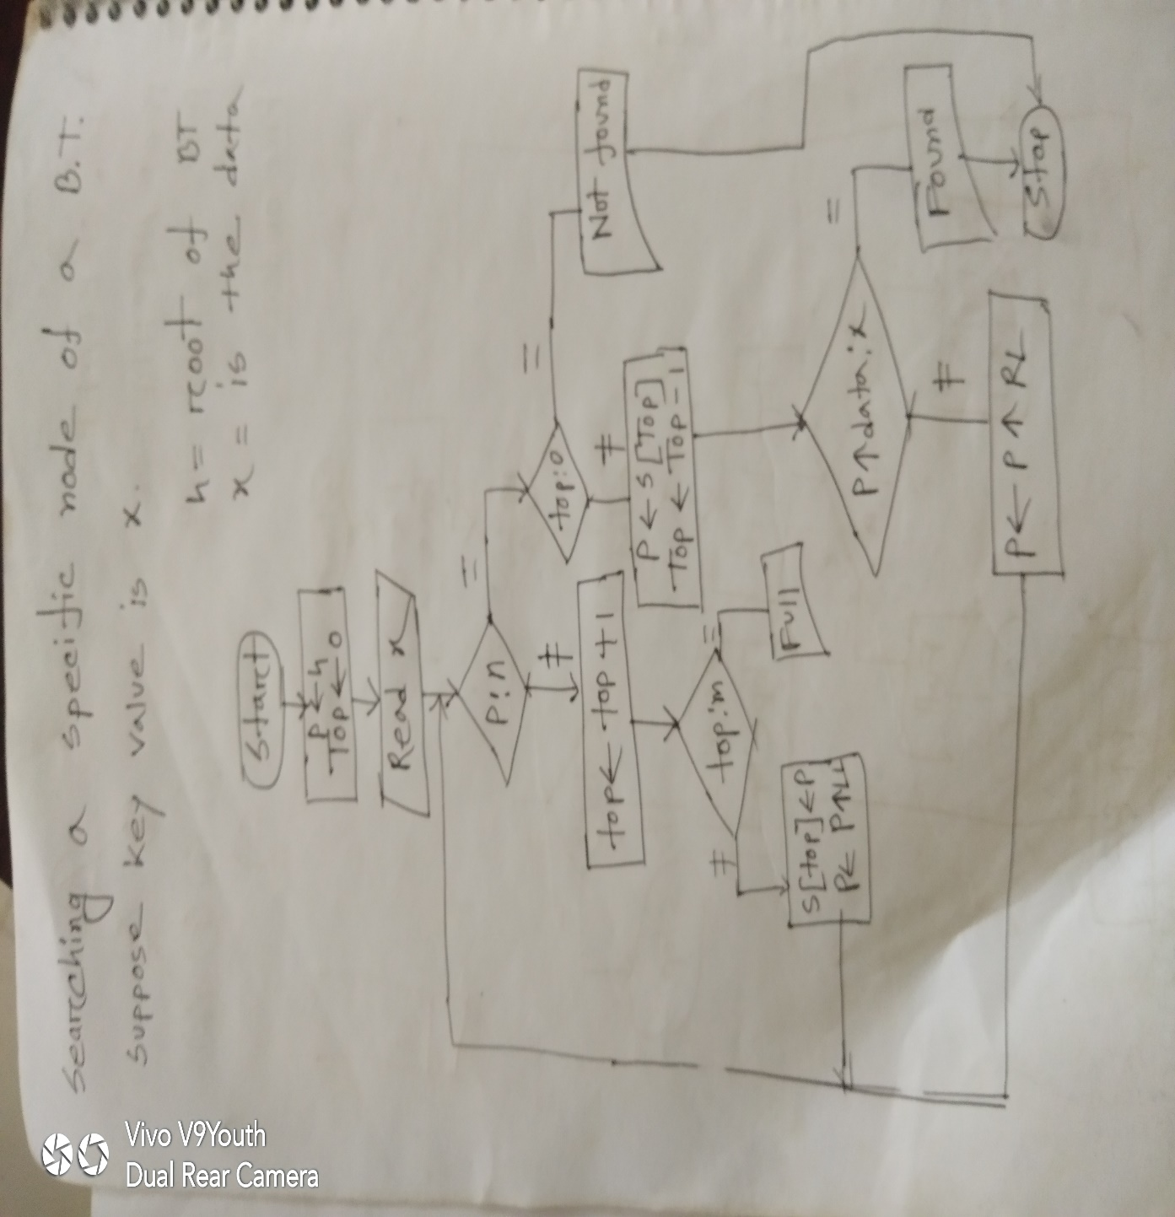
Searching a Specific Node

Slide 28
Introduction to Binary Search Trees
A binary search tree T is a binary tree in which each node N of T has the following property,
a) Left child node is smaller than its parent node.
b) Right child node is greater than its parent node.
40
30
50
25
35
45
60

Slide 29
Binary Tree
Binary Tree is a specialized form of tree with two child. It is simply representation of data in tree structure.

Slide 30
Insertion into Binary Search Trees
Suppose we are given following items to insert on a empty Binary Search Tree(BST),
40, 60, 50, 33, 55, 11
Step 1: Step 2:
Item=40 Item=60
Step 3: Step 4:
Item=50 Item=33
40
40
60
40
40
60
33
60
50
50

Slide 31
Insertion into Binary Search Trees
Step 5:
Item=55
Step 6:
Item=11
40
33
60
50
40
55
33
60
11
50
55

Slide 32
Binary Heap
A Binary Heap is a Binary Tree with following properties.
1) It’s a complete tree (All levels are completely filled except possibly the last level and the last level has all keys as left as possible). This property of Binary Heap makes them suitable to be stored in an array.
2) A Binary Heap is either Min Heap or Max Heap. In a Min Binary Heap, the key at root must be minimum among all keys present in Binary Heap. The same property must be recursively true for all nodes in Binary Tree. Max Binary Heap is similar to Min Heap.

Slide 33
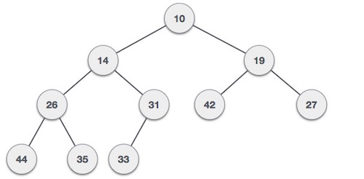
Min Heap
Min-Heap − Where the value of the root node is less than or equal to either of its children.

Slide 34
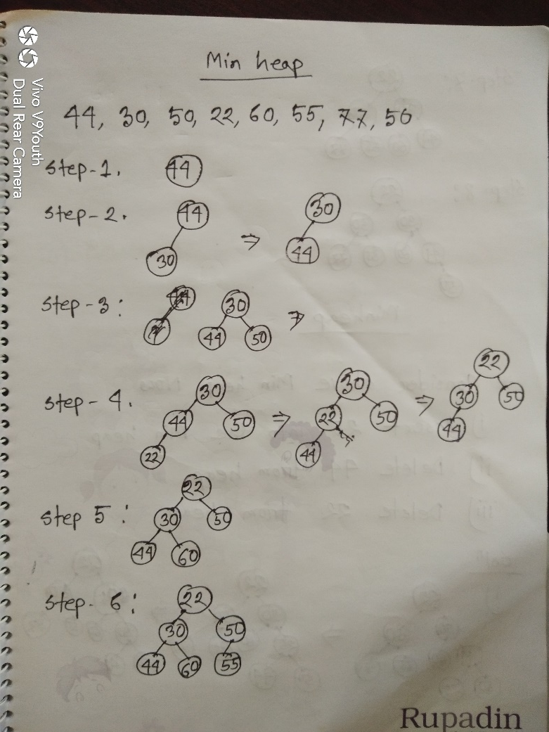
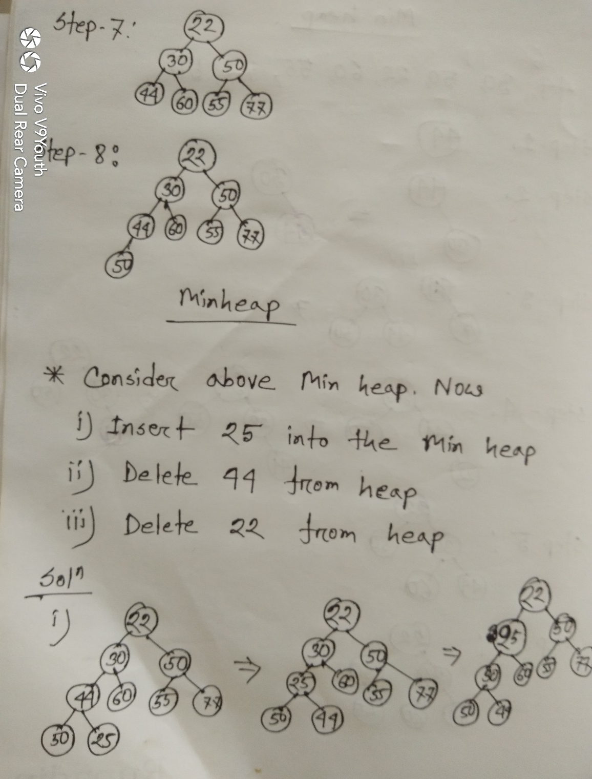
Min Heap

Slide 35
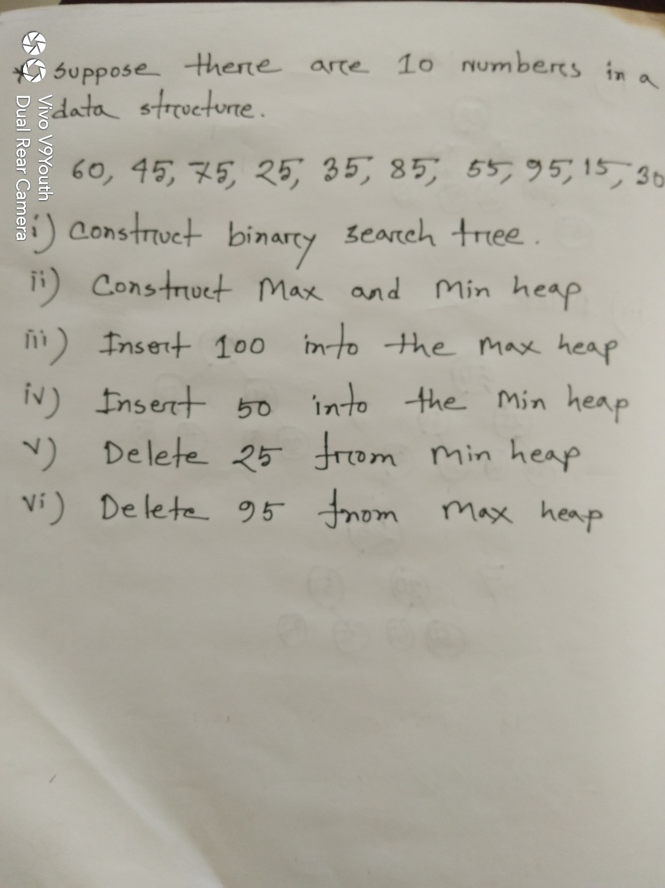
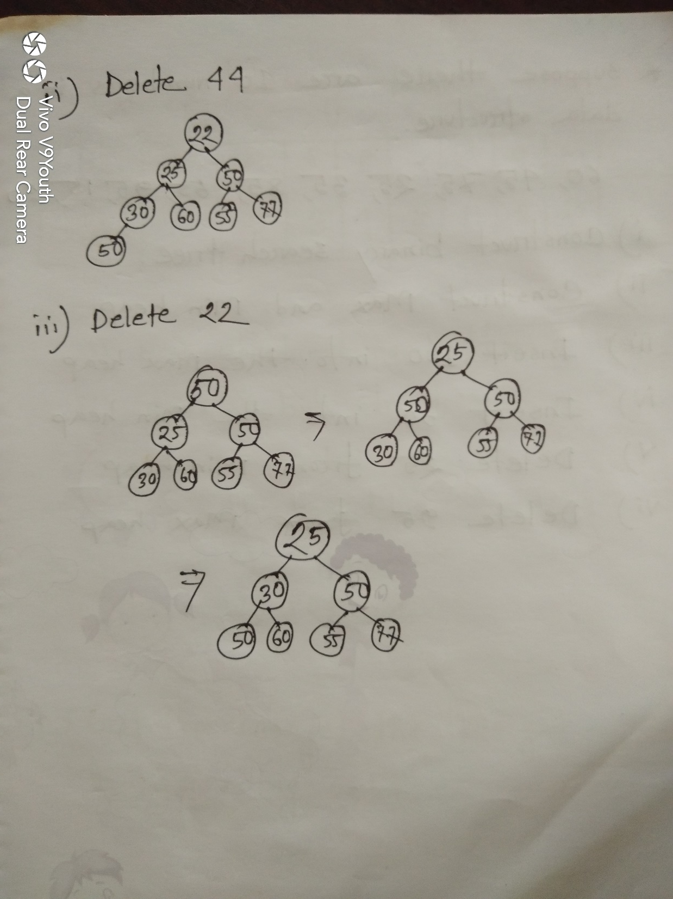

Slide 36
Huffman Tree
Huffman coding is a lossless data compression algorithm. The idea is to assign variable-length codes to input characters, lengths of the assigned codes are based on the frequencies of corresponding characters. The most frequent character gets the smallest code and the least frequent character gets the largest code.

Slide 37
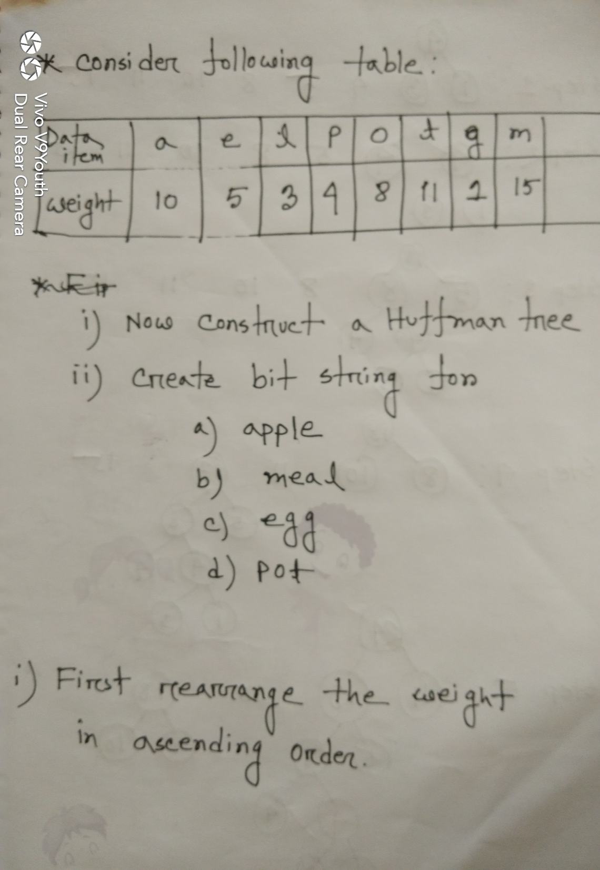
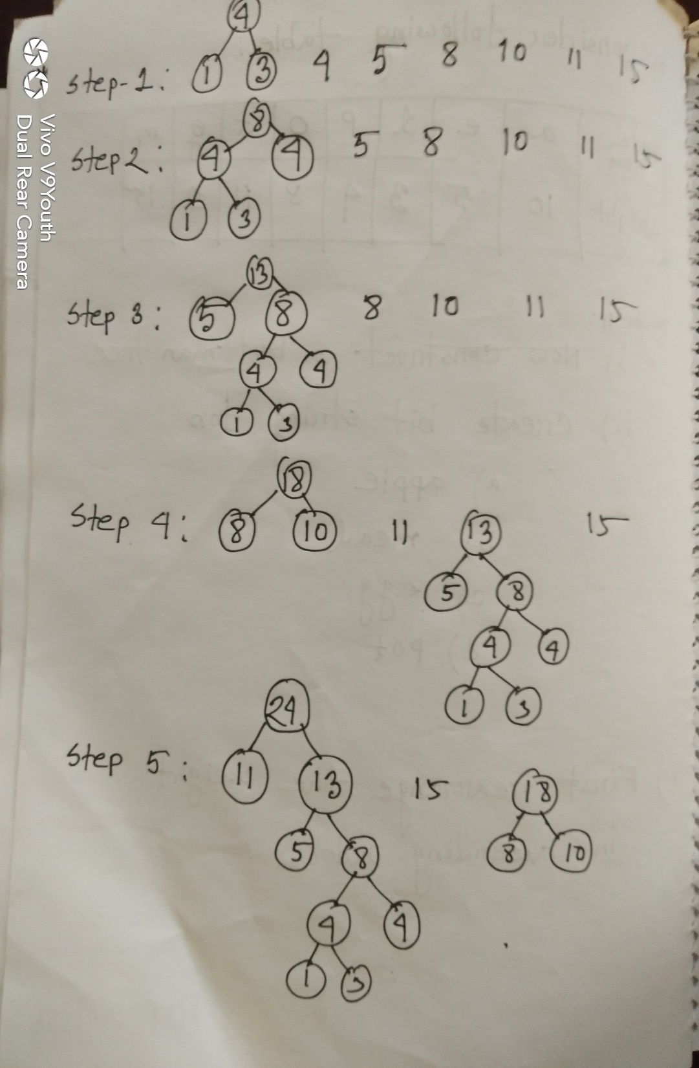

Slide 38
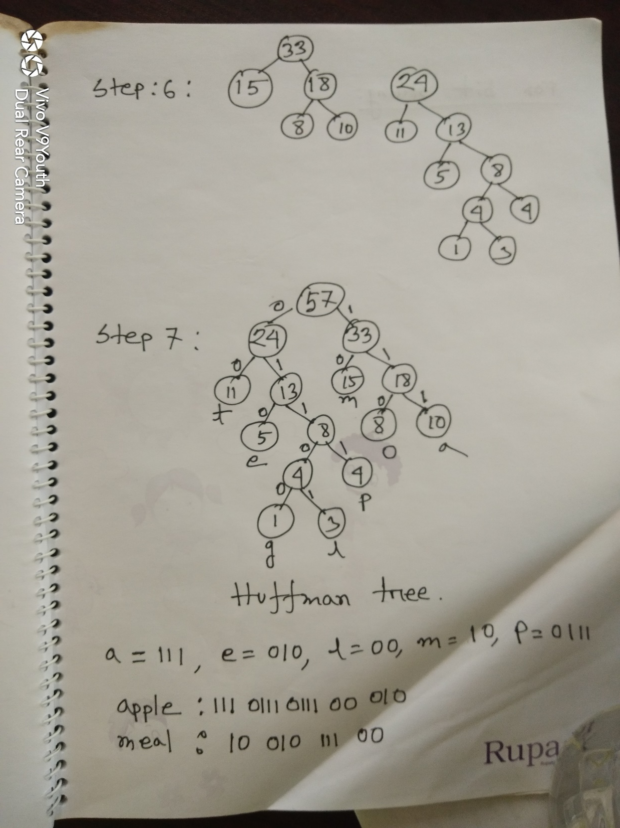

Slide 39
Huffman Algorithm for Data Encoding
Bit(C1)=16*3+5*3=12*3+17*3+10*3+25*3=255
Bit(C2)=16*2+5*4+12*3+17*2+10*4+25*2=212
Character | Frequency | Fixed Length(C1) | Huffman(C2)
A | 16 | 000 | 00
B | 5 | 001 | 1100
C | 12 | 010 | 110
D | 17 | 011 | 01
E | 10 | 100 | 1111
F | 25 | 101 | 10

Slide 40
Huffman Algorithm for Data Encoding
Step 1:
B: 5
E: 10
C: 12
A: 16
D: 17
F: 25
15
C: 12
A: 16
D: 17
F: 25
0
1
B: 5
E: 10

Slide 41
Huffman Algorithm for Data Encoding
Step 2:
27
A: 16
D: 17
F: 25
0
1
C: 12
15
0
1
B: 5
E: 10

Slide 42
Huffman Algorithm for Data Encoding
Step 3:
27
33
F: 25
0
1
0
1
C: 12
15
A: 16
D: 17
0
1
B: 5
E: 10

Slide 43
Huffman Algorithm for Data Encoding
Step 4:
33
52
0
1
0
1
F: 25
27
A: 16
D: 17
0
1
C: 12
15
0
1
B: 5
E: 10

Slide 44
Huffman Algorithm for Data Encoding
Step 5:
85
0
1
33
52
0
1
0
1
A: 16
D: 17
F: 25
27
0
1
C: 12
15
0
1
B: 5
E: 10

Slide 45
Thanks

